Slide 1
Co-Op Experience - Jan-Aug 2021: Reema Yadav

Slide 2
AGENDA
Understanding Steel
SSAB Iowa EAF Asset Health
Data Dictionary Mapper & Pentaho
Anomaly Detection – KAPH Framework
Nucor Berkley Steel – Thrust Force Anomaly Analysis
Learning and experience

Slide 3
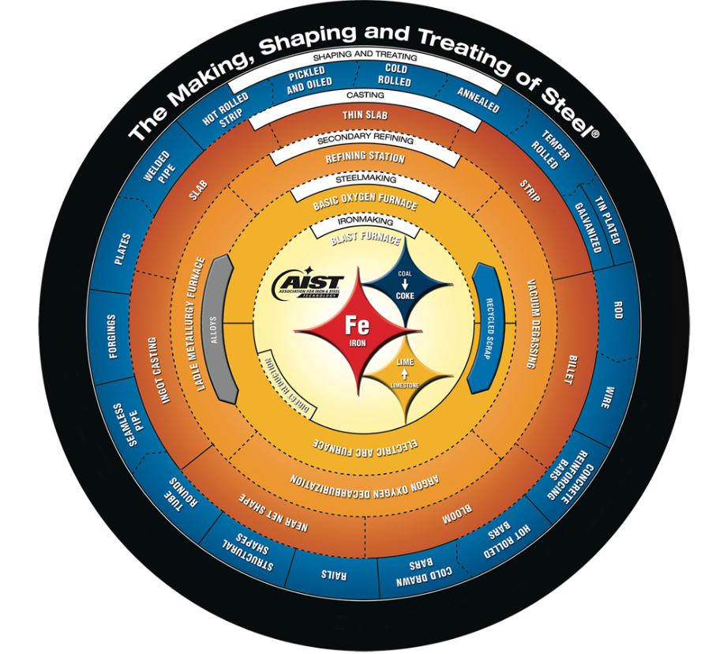
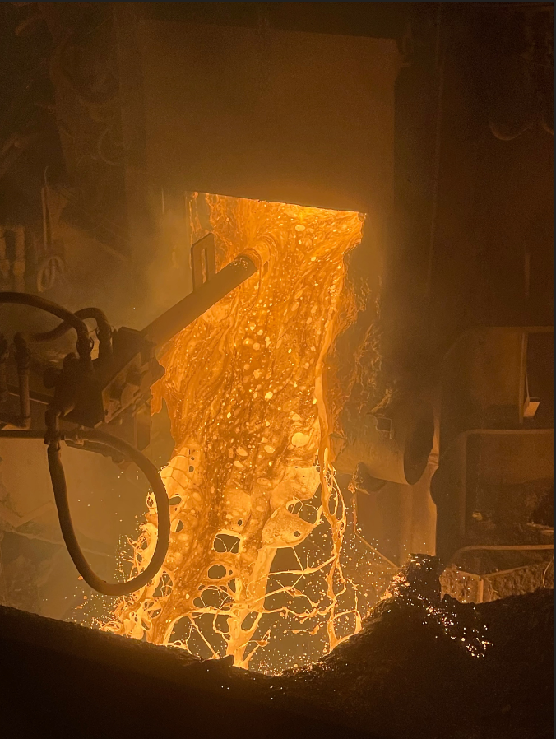
STEEL & SSAB SITE VISIT
Steel – world’s most important engineering and construction material
Steel industry - the business of processing iron ore into steel
Site Visit at Svenskt Stål Aktiebolag (Iowa) objective:
Understanding the steel industry
Getting requirements
Steel making flow – Steel scrapes -> Electric Arc Furnace-> Caster -> Hot Mill
Link: http://apps.aist.org/SteelWheel/index.html
Steel – world’s most important engineering and construction material
Site Visit – understanding the steel industry, requirements

Slide 4
SSAB IOWA EAF ASSET HEALTH
Requirement Gathering
Data collection
Data validation
Asset Hierarchy design

Slide 5
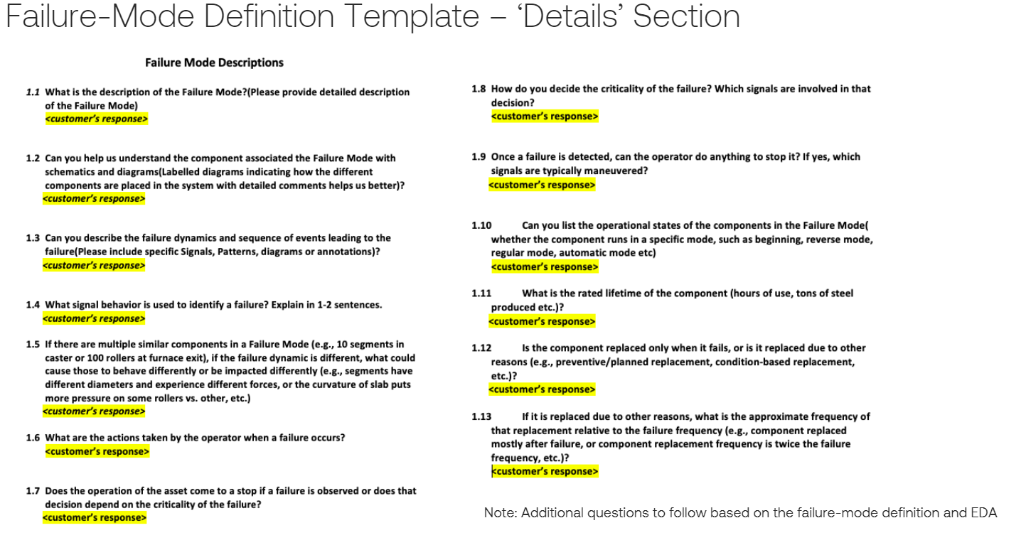
DATA/REQUIREMENT GATHERING
Gathering data:
Raw time series data
Signals
Failure mode definition:
Failure events
Replacement/Repair events
Sensor changes
Machine states

Slide 6
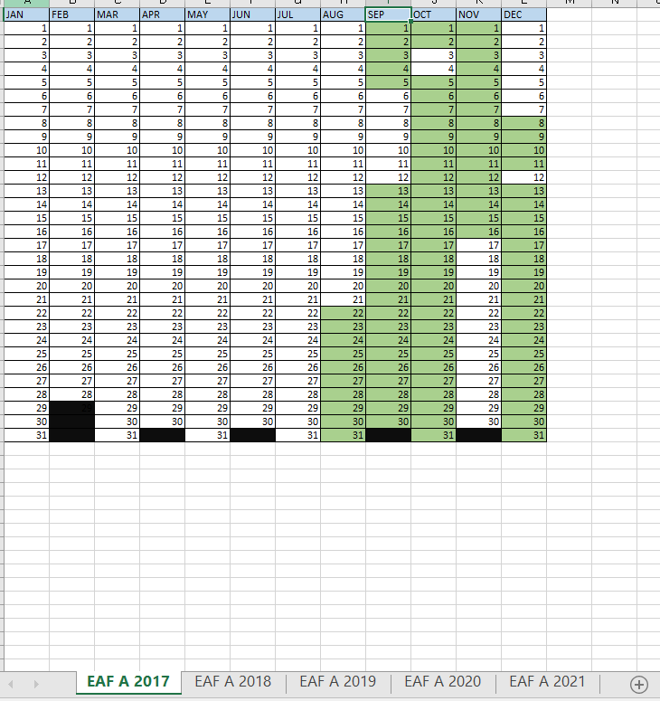
DATA VALIDATION
why - ensures that team can completely trust the data they use to be accurate, clean and helpful at all times
How - Python
Result – Sheet with the valid data created (4 year data)

Slide 7
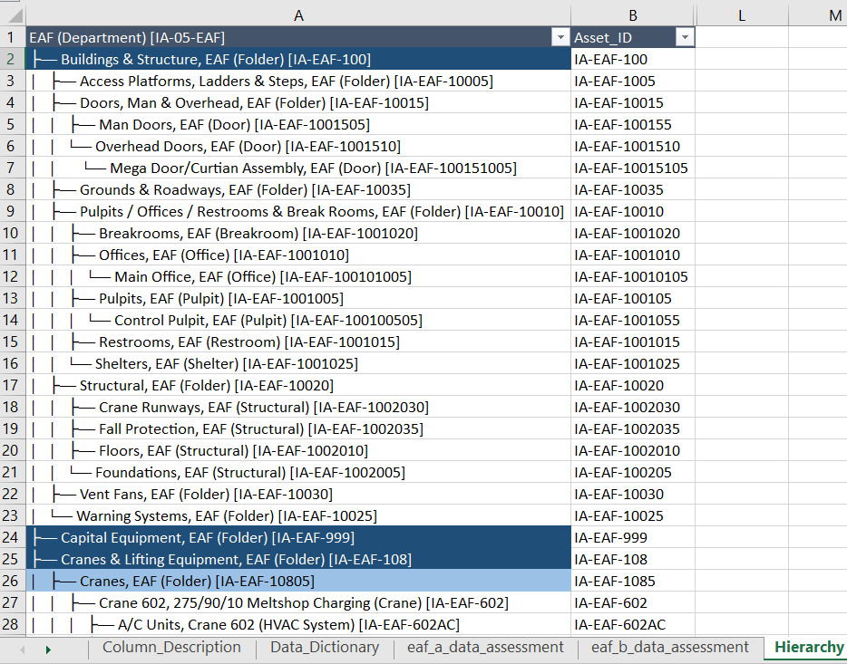
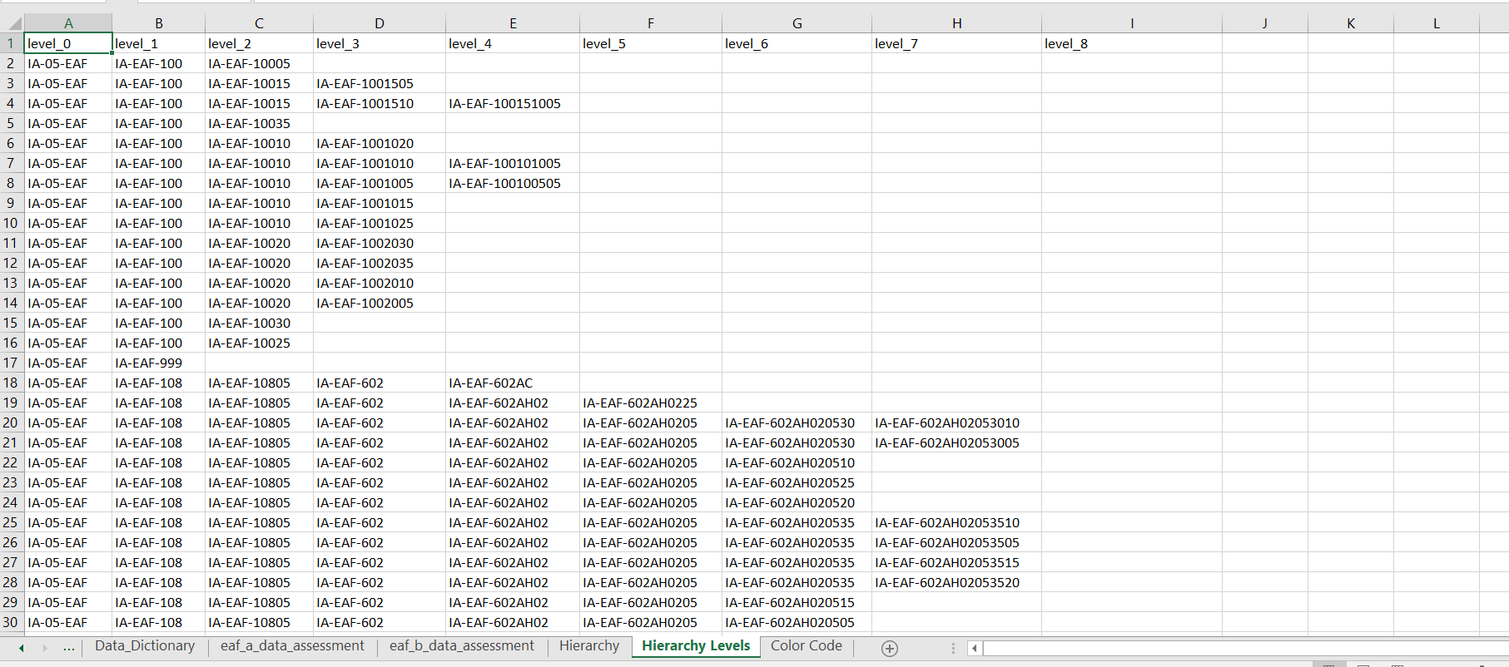
SSAB - ASSET HIERARCHY DESIGN
An asset hierarchy allows companies to organize their equipment and machines stationed

Slide 8
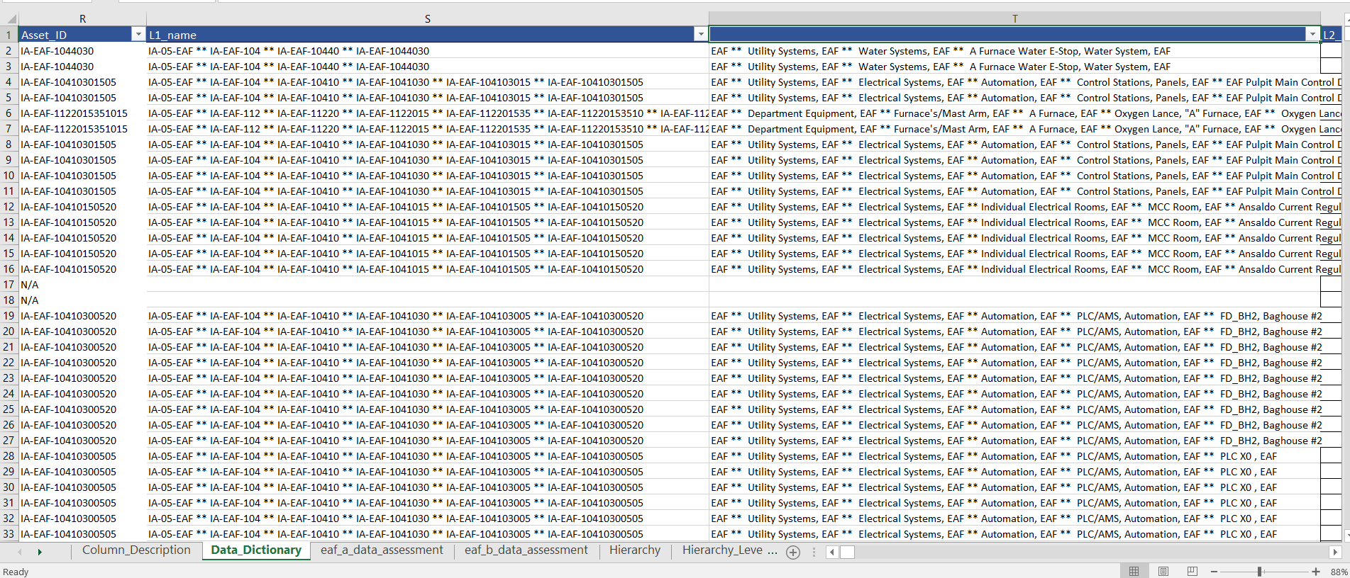
SSAB - ASSET HIERARCHY OUTPUT
A structured, tiered hierarchy allows you to assign proper divisions, systems, parent equipment, and parts for each asset
Designed asset hierarchy to get the hierarchy of asset id and components

Slide 9
DATA DICTIONARY MAPPER & PENTAHO
Data mapping is the process of matching fields from one database to another. It's the first step to facilitate data migration, data integration, and other data management tasks. Before data can be analyzed for business insights, it must be homogenized in a way that makes it accessible to decision makers.
Data Defination/Dictionary mapper - Designed to create database transformation scripts for replication of customer data. Supported data connection- Oracle, Postgres, MySql
We can update undefined types, rename fields, add new fields, generate scripts, update keys etc etc using DDM
Output can be: script files, database diagram and mapping spreadsheet, Optional automatic database creation and executables
Pentaho, a subsidiary of Hitachi Vantara, is an open source platform for data integration and analytics. Pentaho is business intelligence (BI) software that provides data integration, OLAP services, reporting, information dashboards, data mining and extract, transform, load (ETL) capabilities

Slide 10
ANOMALY DETECTION – KAPH FRAMEWORK
Anomaly detection
KAPH Framework
KAPH – Approach
Time series signal
Exploratory Data Analysis
Visual Analysis
Output

Slide 11
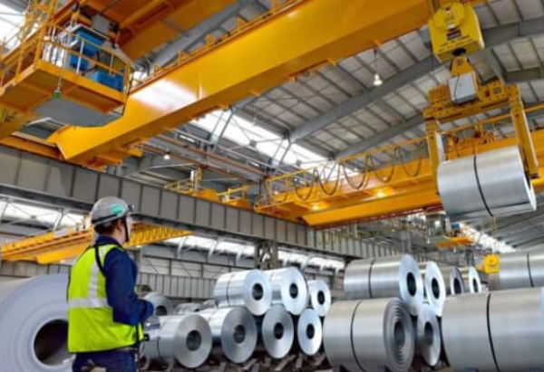
ANOMALY DETECTION
What is anomaly detection?
Any unexpected change in the data pattern, or event that does not conform with expected data pattern is considered to be anomaly. In simple terms, it is deviation from usual business.
It is needed to?
Enhance communication around system behavior
Improve root cause analysis
Reduce the downtime of a system
Event detection in sensor system
Systems health monitoring

Slide 12
KAPH FRAMEWORK
What is KAPH Framework?
Time Series Understanding
Exploratory Data Analysis
Stationarity of Data – ADF and Rolling Statistics
Conversion to stationary if non stationary
Time series decomposition
ACF and PACF
Building model - varies
Output: End to end Jupyter notebook created

Slide 13

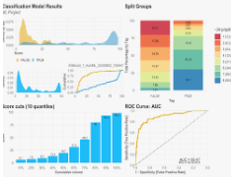
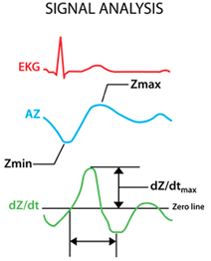
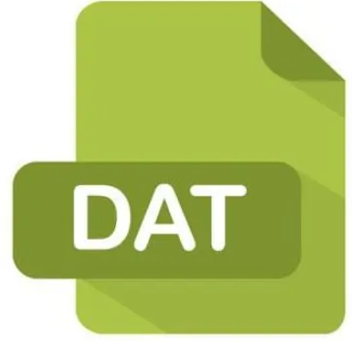
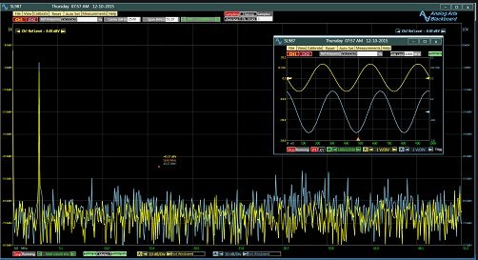
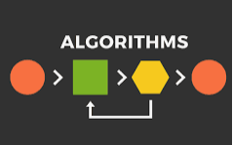
KAPH - APPROACH
Analysing the time
series signals using AI/ML
Algorithms in python
Dat File
Prediction/Modeling

Slide 14
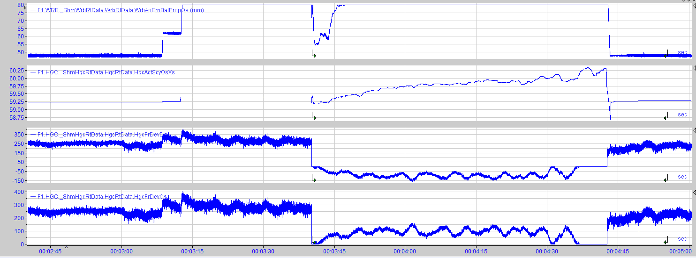
TIME SERIES SIGNAL
What is time series data?
Collection of data observations obtained through repeated measurement over time used for trend analysis is time series data.
It is used to?
Predict the future failure in components
Implement some useful concept in the industry
Helps to make good decision
Prevent capital losses

Slide 15
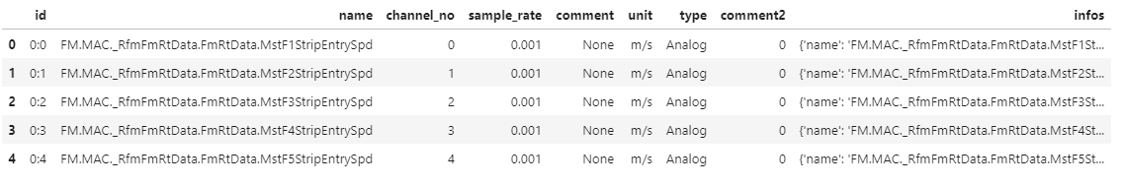
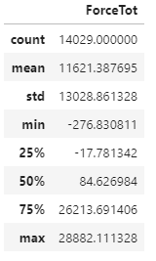
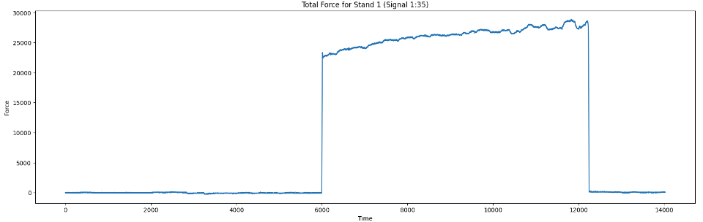
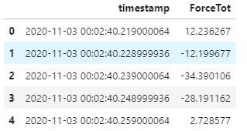
EXPLORATORY DATA ANALYSIS
List of Channel and Signal Information
Extracting a particular signal

Slide 16
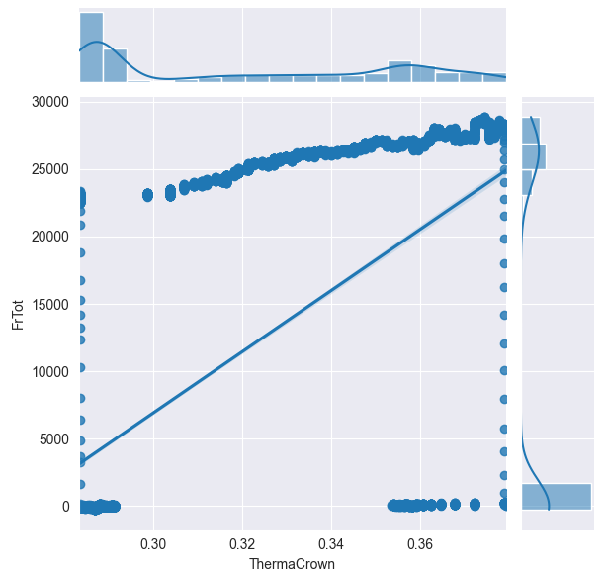
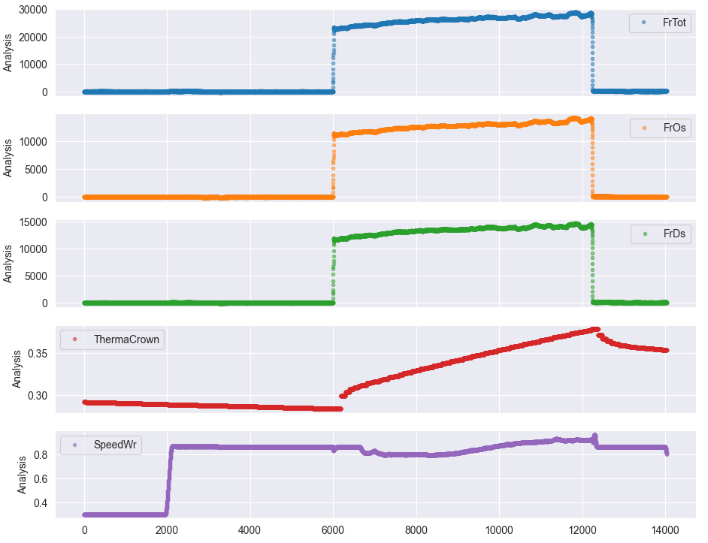
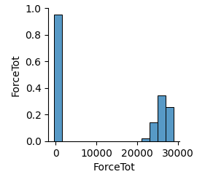
VISUAL ANALYSIS

Slide 17
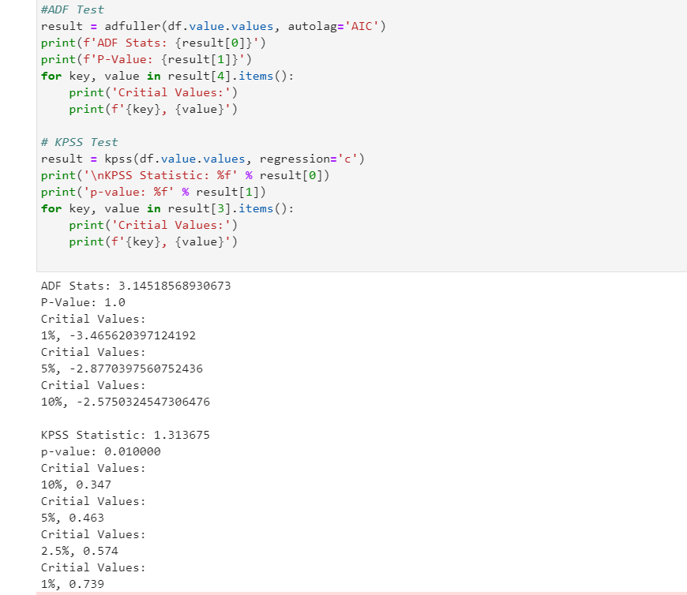
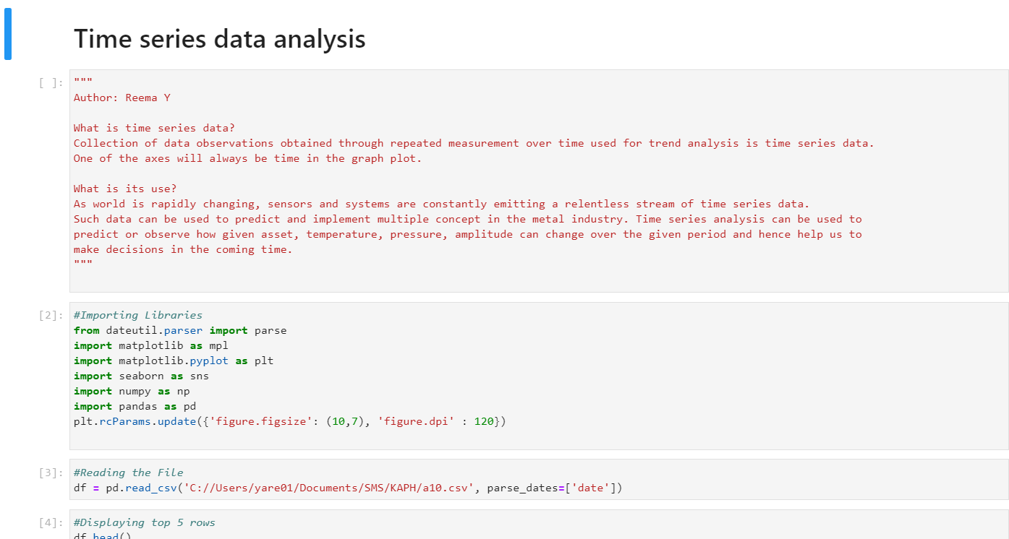
OUTPUT

Slide 18
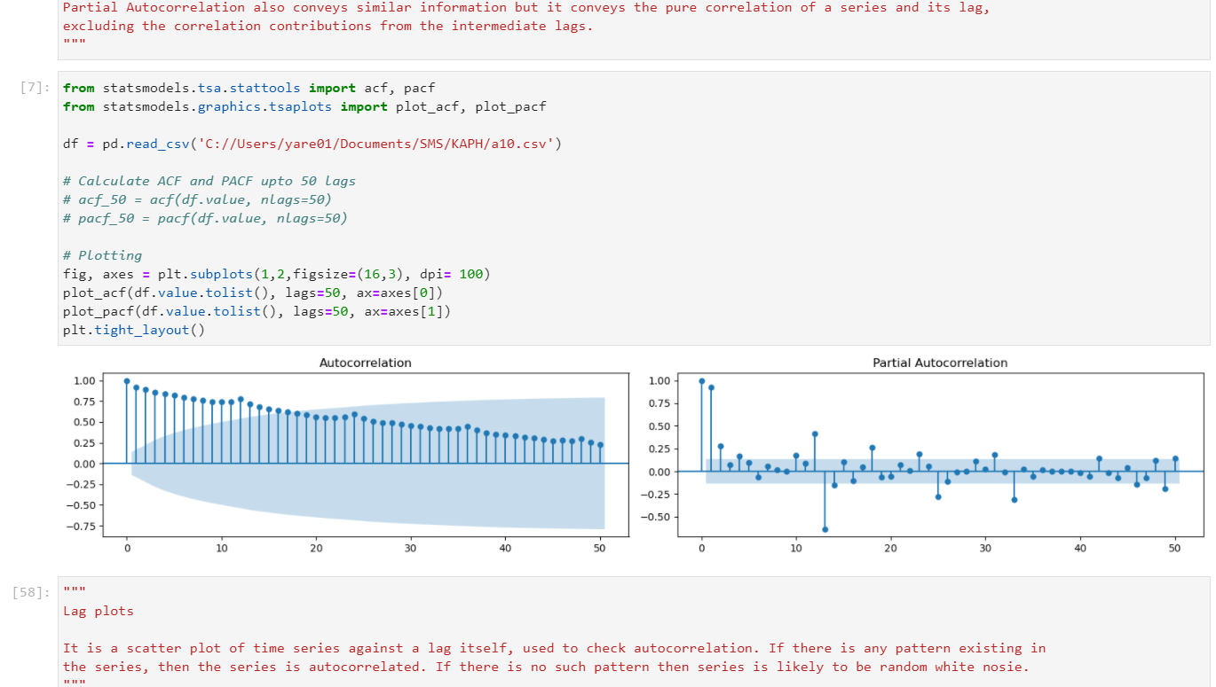
OUTPUT

Slide 19
NUCOR BERKLEY STEEL –THRUST FORCE ANOMALY
Data extraction and validation
Data Cleaning
Signal Analysis
Development
Challenges
Result

Slide 20
NUCOR BERKLEY STEEL –THRUST FORCE ANOMALY ANALYSIS
Requirement : To view multiple data signals keeping two force signal constant and understanding the pattern
Reading the Ibafile and plotting it in application after normalizing the data. Different functionalities present such as selecting signals, multiple dat files, plot button, hovering over signals, zoom in and zoom out, legend hiding, mapping the plot with a table.
Extracted the Coil number from multiple signals in ascii code.
Result: Designed an application

Slide 21
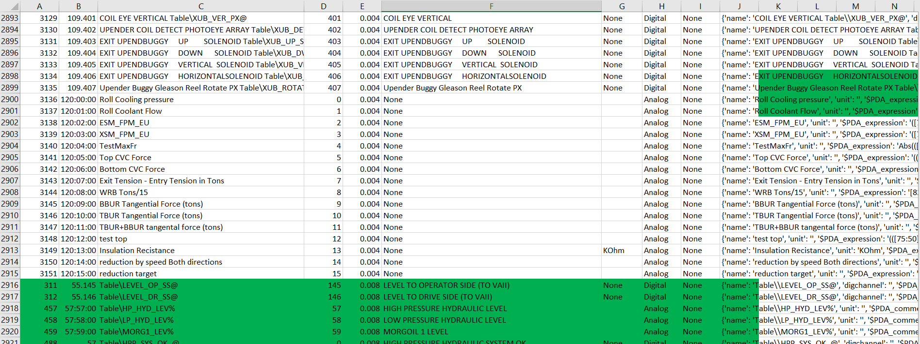
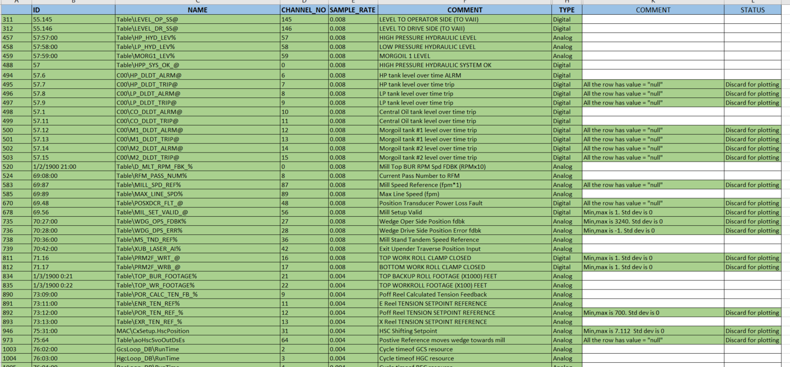
DATA EXTRACTION & VALIDATION
Required signal information extracted from raw file and validated

Slide 22
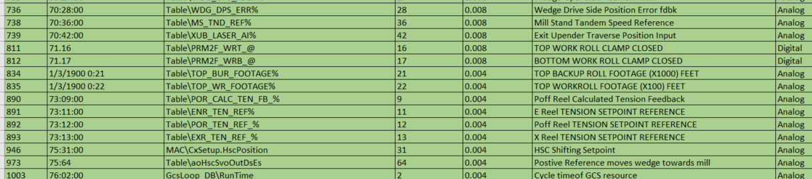
SIGNAL ANALYSIS
All the signal has sample rate as 0.004 or 0.008

Slide 23
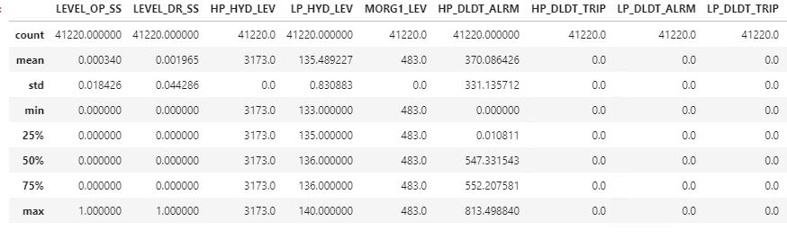
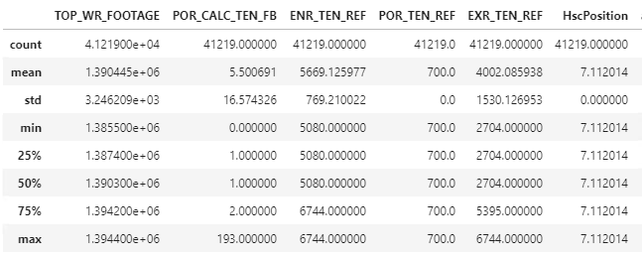
DATA CLEANING
Some signals has null values only – can be discarded for plotting
Some signals has some value which is constant in all rows – can be discarded for plotting as mean, min, max, percentile are all same and standard deviation is 0

Slide 24
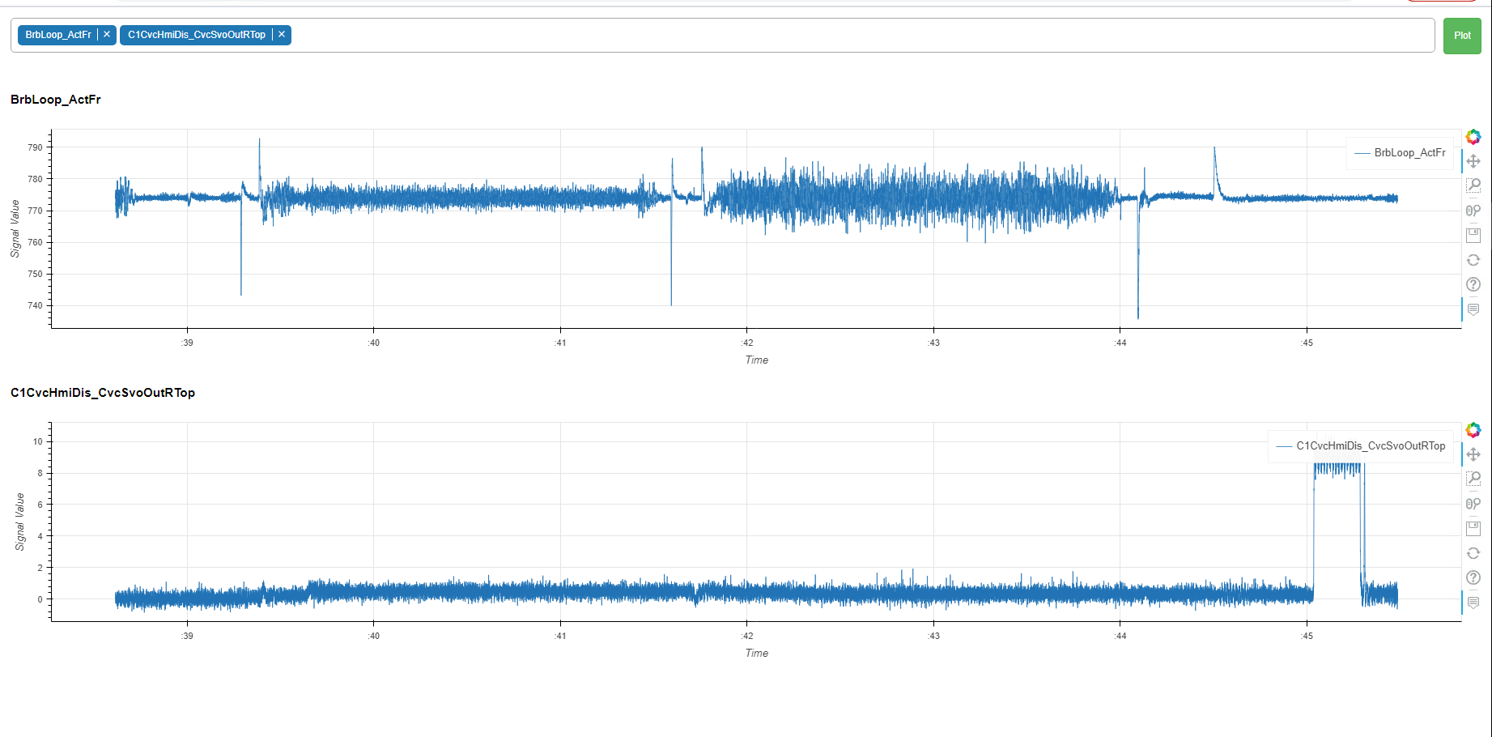
DEVELOPMENT PHASE 1

Slide 25
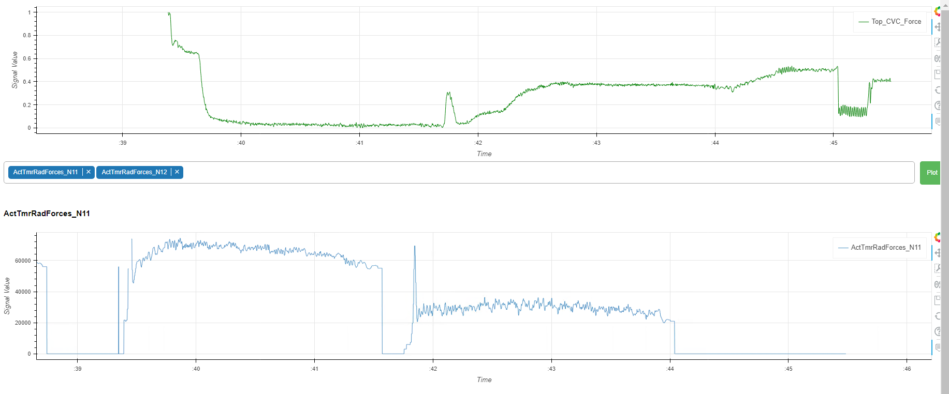
To Overcome above challenges:
Data was normalized so that it can have the same y- scale
Data sampled at the same frequency

Slide 26
CHALLENGES
Adding new signal to the constant plot is making WebSocket disconnected, hence crashing the web server
Solution – created the list of signals req and used it
2. Normalizing the data is impacting the constant value as they have zero standard deviation
Solution – used max absolute normalization technique
3. Coilnumber was not present
Solution – read the signals ascii code and converted them to numbers and then merged them
4. Coil end time was not present
Solution – got the end time by analyzing the pattern of the signal

Slide 27
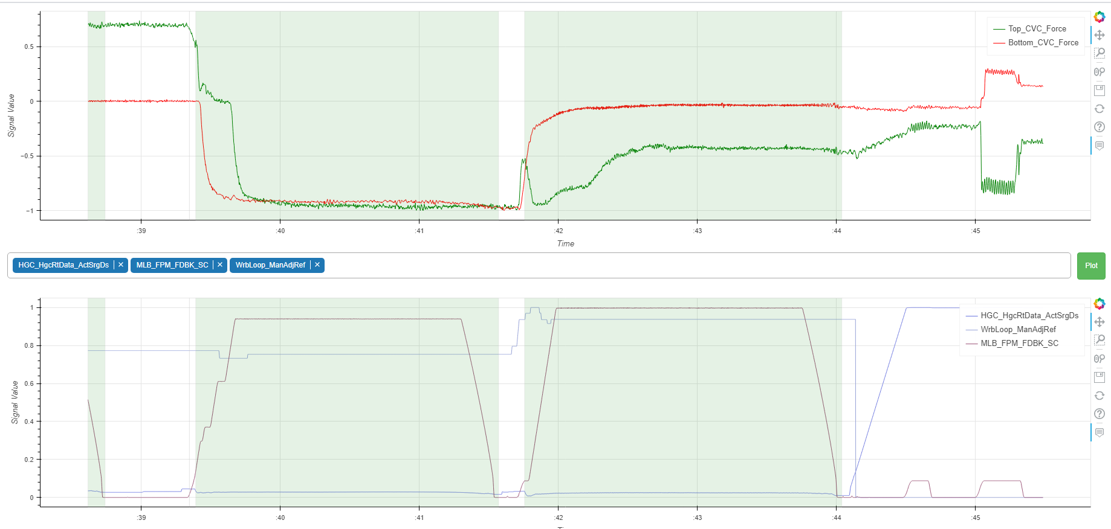
DEVELOPMENT PHASE N

Slide 28
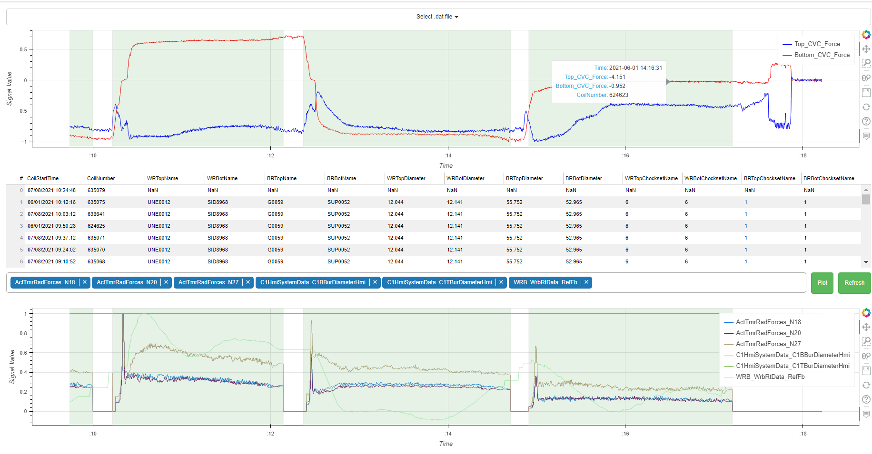
CURRENT STAGE

Slide 29
LEARNING & EXPERIENCE
Technical – Data Science pipeline (Extraction, cleaning, visualization, modeling)
ARIMA( AutoRegressive Integrated Moving Average): Mathematical ML modeling for time series
Python: programming language
SQL: lag and lead function
Bokeh: visualization library
IBA Analyzer: industry standard signal analytics tool
Domain Knowledge – Manufacturing industry
Personal – Understanding of SMS Group/ SMS Digital Business and work culture
Social – Pittsburgh

Slide 30


